Slide 1

Team Name : Team Anthrobot
Institute Name: SRM Institute of Science and Technology, Kattankulathur

Slide 2

Team Member Details
Team Name | Team Anthrobot
Institute Name | SRM Institute of Science and Technology, Kattankulathur
Team Members > | 1 (Team Lead) | 2 | 3 | 4
Name | Gyanesh Samanta | Souvik Dey | N Aditya Sai | Aman Sharma
Batch | 2019-2023 | 2019-2023 | 2019-2023 | 2019-2023
Area of expertise | Ideation, Programming layout, management | Cost estimation, Team coordination, Management | CAD Designer (Blender), Ideation | IoT hardware Design, Part Selection, Video Editing

Slide 3
Robot Specifications and Functionality
Component | Functionality
Raspberry Pi Zero W | Brain of our Anthrobot.
Camera Sensor | To provide visual data from the gauges of blast furnace.
Servo motor | Movement mechanics for the arms of our robot.
AC motor | To power the wheels using gears.
AC to DC Converter | To power Electronic components.
Aluminium Kevlar | This is the material used by people as protective shield in the blast furnace. This aids Anthrobot to sustain high temperatures.

Slide 4
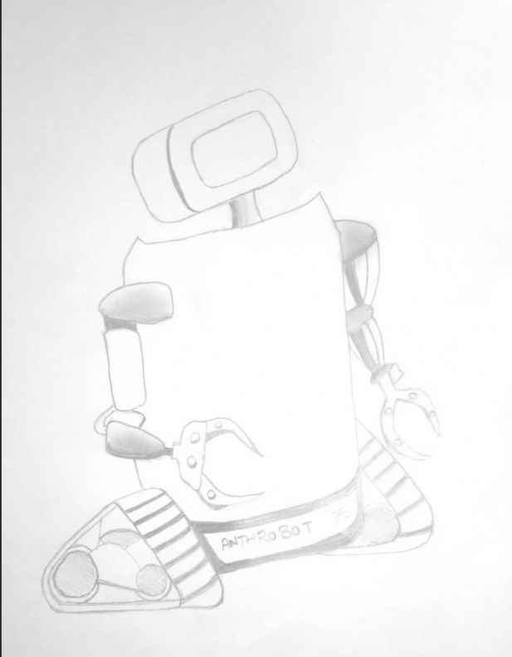
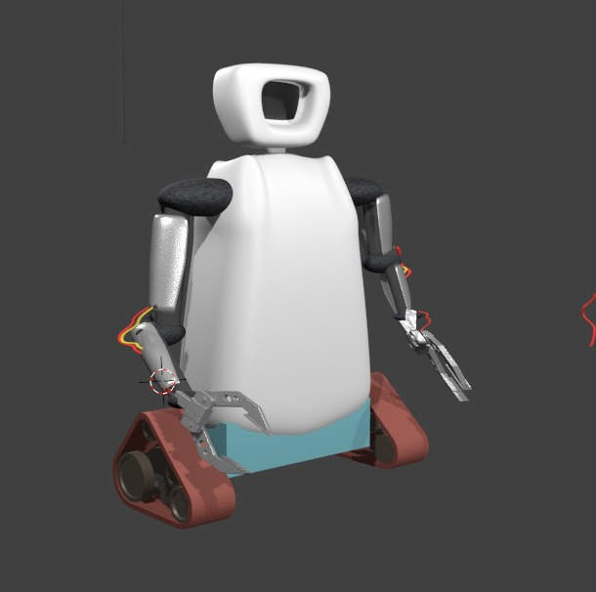
Robot Visualization -3D Diagram/Sketch
Hand-drawn Sketch
Rendered view on Blender

Slide 5
Architecture
The camera module is placed behind the glass door of Anthrobot’s head, This allows it to read and transmit video data that is displayed on the gauges of the blast furnace.
The arms move in 2 axes with the help of Industrial Grade Servo motors which allows Anthrobot to perform its tasks.
The wheels were inspired by the robot Wall-E and chosen just on the basis of robot body stability.
For base structure of body, Anthrobot will be made up of Stainless Steel covered with Aluminium Kevlar.
Anthrobot visualisation
(Made using Blender)

Slide 6
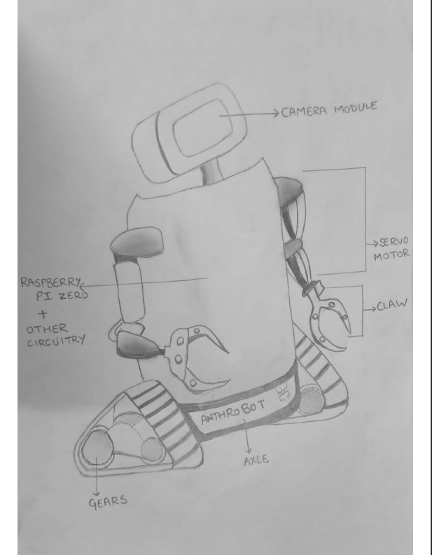
Assembly
The camera module is behind the glass door in Anthrobot’s head.
The servo motors are placed in the elbow joint, which allow the arm movement in x and y axes.
The claw adds the ability for the robot to push the cart of XRF Spectroscopy Machine and perform other tasks.
The wheels provide movement mechanics and balance to the Anthrobot.
Preliminary planning of Anthrobot

Slide 7
Required Calculations (Cost estimation)
Component | Price | Link to buy
Raspberry Pi Zero W | Rs. 1750 | shorturl.at/rIJ39
AC Motor | Rs. 4680 | shorturl.at/hjtvy
Camera Sensor | Rs. 549 | shorturl.at/cuLOR
Servo motor | Rs. 1500 x 4 | shorturl.at/ehDUY
AC to DC Converter | Rs. 475 | shorturl.at/oGR28
Aluminium Kevlar | Rs. 1600 / m | Already used by people who work in the blast furnace.

Slide 8
Programming Module Explanation
Anthrobot has been programmed for these main tasks:
To use Computer Vision for movement, for Anthrobot to move to the Blast furnace, check the gauges and move back.
To perform 2 tasks at the Blast Furnace:
To show a live video of the readings displayed by the digital gauges near the blast furnace over to a video receiving device (e.g. smartphone)
To perform the occasional purity check , XRF spectroscopy.
Development required:
A simple application to receive video feed from the Anthrobot. (Optional)
Programming for the raspberry pi, for Computer vision based movement and performing of pre-programmed tasks.
(Please find an activity diagram of the same in the next slide)

Slide 9
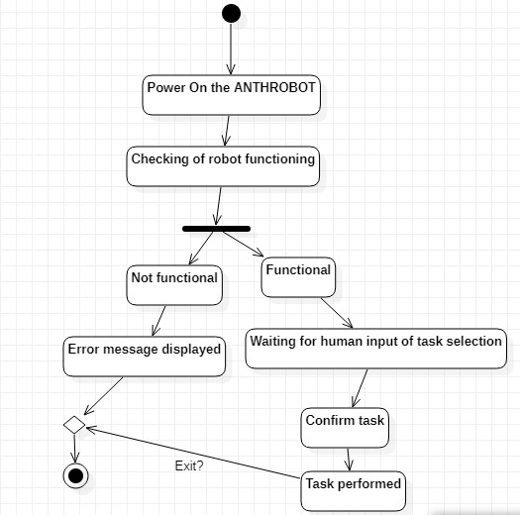
Simulation and Project Video:
Google drive link:
https://drive.google.com/file/d/11nWCYKlk4k0mYLkBHsc59prwk-2-yjUY/view
Additional information (Detailed):
https://docs.google.com/document/d/1iAIOziqN0hAw7LFTdXbsdTXZ2cFpDC8SR-gHVdaVDH4/edit

Slide 10


